Slide 1


FCB Introduction
New Certification Tracking Database System
Overview

Slide 2
Welcome
Welcome to the Florida Certification Board's introductory training on our new certification tracking system for Florida's Child Welfare Certification Program.
The purpose of today's session is to provide a high-level overview of the new system and demonstrate how it will support applicants, trainers, employers, and the certification process.
This is the first in a series of recorded training modules.
Future recorded trainings will provide step-by-step instruction for each user role and specific certification activities.

Slide 3
Agenda
In this session, we will demonstrate three key processes:
How a new applicant applies for the Child Welfare Provisional credential using the Applicant Portal.
How the Employer Portal enables organizations to manage employee certification activities, including identifying current employees, verifying required documentation such as qualifying college degrees and eligible criminal background status, and paying certification fees on behalf of staff.
How the Training Provider/Point of Contact Portal is used to document, monitor, and process training and credentialing activities.

Slide 4
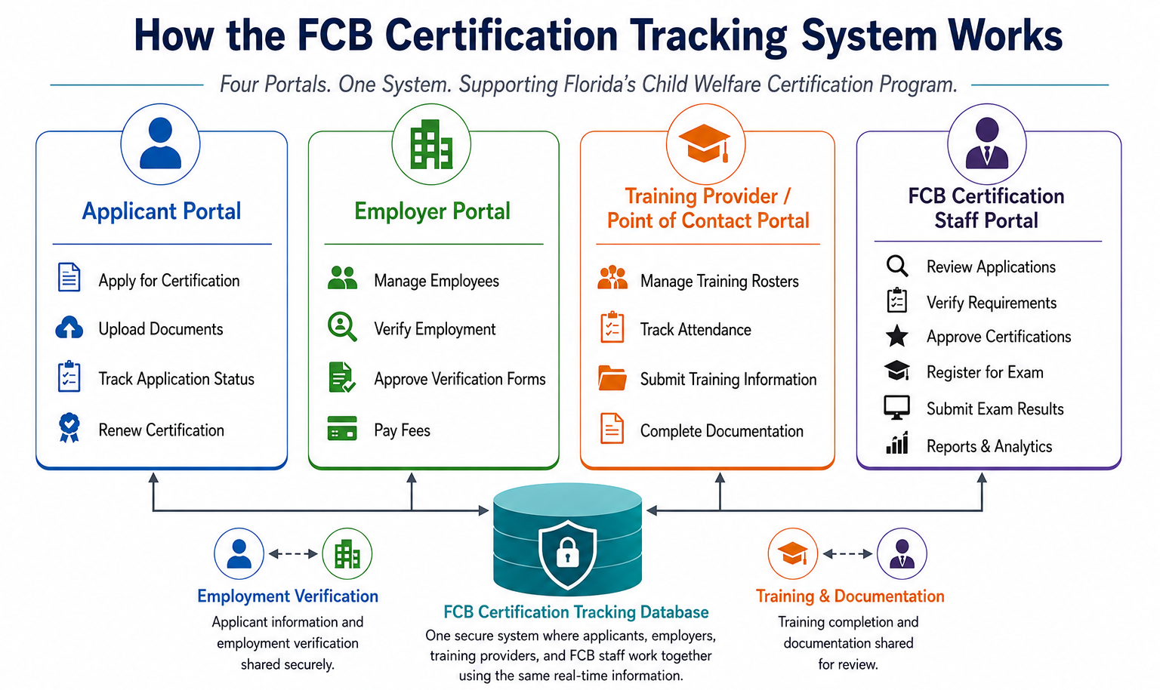

Slide 5
What Has Changed?
Previous FCB System | New FCB System
Multiple forms | One online application
Email documents | Upload directly
Manual tracking | Real-time dashboard
Call FCB for status | Check status anytime
Paper forms | Electronic workflow
Separate communications | Email & Text Notifications
Manual follow-up | Automatic reminders
Limited visibility | Real-time status for everyone

Slide 6
Training Provider/Point of Contact Responsibilities
The Point of Contact:
Creates the Roster
Manages the Attendees
Completes the Training
Administers the Exam
Manages the Provisional Assessments/Field Observations
The Point of Contact ensures applicants are progressing through the certification process in a timely manner.

Slide 7

Child Welfare Provisional Workflow
Meet Our New Employee
A newly hired Child Welfare Protective Investigator (CWPI-P)
Create Account
Select Credential
Employer Verification
Complete Application
Submit Application
Monitor Status
Create Training Roster
Complete Remaining Requirements
Complete the Training
Take the Exam
Complete the Assessments/Observations
Become Certified

Slide 8
Who Does What?
User | Responsibility
Applicant | Apply, upload documents, monitor progress, attend training, and take the exam
Employer | Verify Level 2 background, verify employment, verify formal education, and pay fees
Training Provider | Create the roster, track attendance, complete the training, proctor the exam, and submit the provisional assessments
FCB Staff – Certification Specialists and Examiner | Review, final approval, exam registration, import exam results, and issue certification

Slide 9
Demonstration

Slide 10
Thank You for Joining Today's Webinar!
Today We Covered:
✔ Overview of the New FCB System
✔ Benefits of the New System
✔ Child Welfare Provisional Workflow
✔ Applicant Portal
✔ Employer Portal
✔ Training Provider Portal
✔ Demonstration of the New FCB System
Future Webinars:
Child Welfare Upgrade Workflow
Child Welfare Exam Waiver Workflow
Child Welfare Additional Discipline Workflow
Child Welfare Renewal Workflow

